Slide 1
Unit - 2
Neural Network Training

Slide 2
Loss Function
A loss function is a function that compares the target and predicted output values

Slide 3
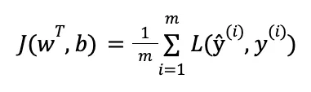
Hyperparameters are adjusted to minimize the average loss

Slide 4
Types of Loss Functions
1) Regression Loss Functions
2) Classification Loss Functions

Slide 5
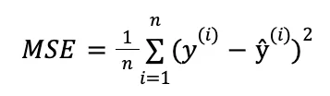
Mean Squared Error (MSE)

Slide 6
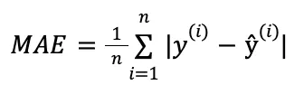
Mean Absolute Error (MAE)

Slide 7
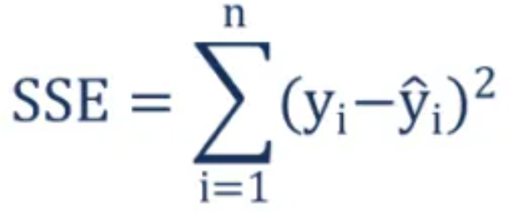
Sum of Squared Error (SSE)
y_{i} – the observed value
ŷ_{i} – the value estimated by the regression line

Slide 8
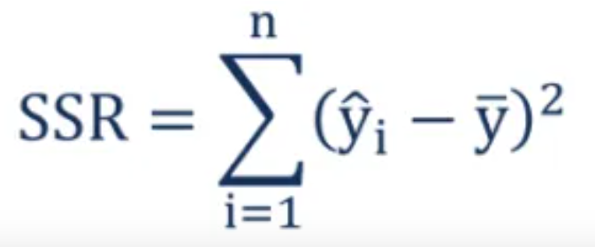
Regression sum of squares

Slide 9
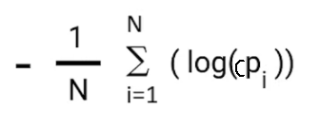
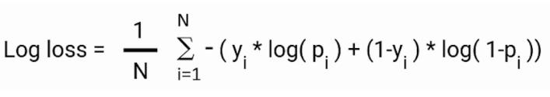
Cross-Entropy Error /Log Loss
Negative average of corrected probabilities
Cross-Entropy Error (Log loss)

Slide 10
Mini-Batch Learning
While training the NN, update the training weights several times over the course of a single epoch.
Here, we are not computing the true gradient; instead we are computing an approximation of the true gradient, by using many training samples which are included in each split of the epoch. This is known as mini-batch learning.

Slide 11
Gradients for neural network
An optimization algorithm used to train machine learning models by minimizing errors between predicted and actual results.
Learning rate ( step size) : the size of the steps that are taken to reach the minimum.
The cost (or loss) function measures the difference, or error, between actual y and predicted y at its current position. This improves the machine learning model's efficacy by providing feedback to the model so that it can adjust the parameters to minimize the error.

Slide 12
Types of Gradient Descent
Batch gradient descent: sums the error for each point in a training set, updating the model only after all training examples have been evaluated. This process referred to as a training epoch
Mini-batch gradient descent: Mini-batch gradient descent combines concepts from both batch gradient descent and stochastic gradient descent. It splits the training dataset into small batch sizes and performs updates on each of those batches
Stochastic gradient descent: Stochastic gradient descent (SGD) runs a training epoch for each example within the dataset and it updates each training example's parameters one at a time.

Slide 13
Thank you

